Slide 1

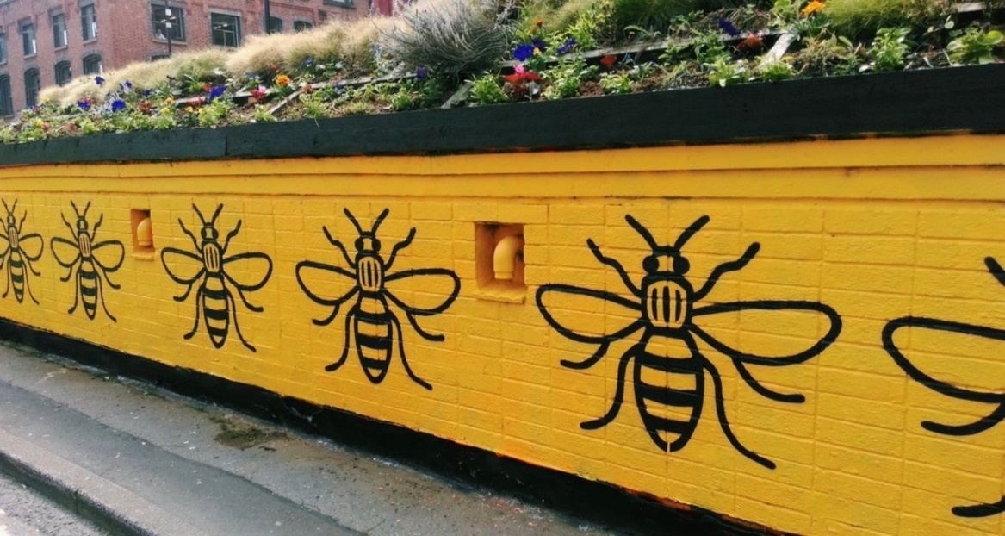
Recovery and Adjustment
Notes:
LK – 1 min

Slide 2
Promote the use of Social Support
Encourage social connections and a return to previous activities.
Encourage communication
Social media
Promote and encourage existing coping strategies
Notes:
LK – 2 mins
Information on Coping
Offer information and advice on coping with trauma
Direct young people to resources and sources of support
Promote and encourage existing coping strategies
1) Facilitate peer support
2) /listen – do not question or ask for details about the event
3) Discourage the use of social media/viewing media coverage where there are graphic images and constant reminders.

Slide 3
Information on Coping
Offer information and advice on coping with trauma
Direct young people to resources and sources of support
Promote strengths and encourage existing coping efforts. Be open to learning new strategies as well as unearthing dormant skills.
Notes:
LK – 1 min

Slide 4
Information on Coping
Counselling/ therapy soon after a major trauma is not advisable and may actually make things worse:
People can be re-traumatised
Counselling/ therapy can give the unintentional message that there is ‘something wrong’ with the person
Group debriefing can also be harmful
Notes:
LK – 2 mins
We cannot assume that everyone who has experienced the traumatic event will be traumatised and requires specialist intervention
1) re-traumatised- which could prevent the recovery process.
2)
3) as not everyone will have witnessed the same scenes and young people can be traumatised by what they hear.

Slide 5
Exercise
Refer to the scenario and consider:
How would you communicate the incident to staff, pupils and parents?
Identify who is most vulnerable following the incident, what support would you plan for them and how would you monitor these individuals?
How would you acknowledge the incident to the family and what arrangements would you make to memorialise the deceased? What precautions would you need to take?
How would you ensure self-care for you and your senior leaders?
Notes:
RT – 25 mins

Slide 6
POST TRAUMATIC GROWTH
Post traumatic growth is positive change experienced as a result of the struggle with a major life crisis or a traumatic event.
Notes:
RT – 1 min
What is Post traumatic growth? – see definition on slide
Although we coined the term posttraumatic growth, the idea that human beings can be changed by their encounters with life challenges, sometimes in radically positive ways, is not new. The theme is present in ancient spiritual and religious traditions, literature, and philosophy. What is reasonably new is the systematic study of this phenomenon by psychologists, social workers, counsellors, and scholars in other traditions of clinical practice and scientific investigation.

Slide 7
What forms does post traumatic growth take?
Post traumatic growth tends to occur in 5 general areas.
1. New opportunities opened up
2. A change in relationships
3. Increased sense of own strength – “If I lived through that, I can face anything.”
4. Greater appreciation of life
5. A deepening of one’s spiritual life
Notes:
RT – 1 min
1. Sometimes people who must face major life crises develop a sense that new opportunities have emerged from the struggle, opening up possibilities that were not present before.
2. A second area is a change in relationships with others. Some people experience closer relationships with some specific people, and they can also experience an increased sense of connection to others who suffer.
3. A third area of possible change is an increased sense of one’s own strength – “if I lived through that, I can face anything”.
4. A fourth aspect of posttraumatic growth experienced by some people is a greater appreciation for life in general.
5. The fifth area involves the spiritual or religious domain. Some individuals experience a deepening of their spiritual lives, however, this deepening can also involve a significant change in one’s belief system.

Slide 8
Model of PTG in children
(Cryder et al., 2004)
Pre-trauma beliefs
Trauma
Extended model (see Kilmer, 2005)
Ruminative thinking
Social
support
Competency beliefs
PTG
Notes:
RT – 1 min
Rumination is the focused attention on the symptoms of one's distress, and on its possible causes and consequences, as opposed to its solutions. Both rumination and worry are associated with anxiety and other negative emotional states

Slide 9
Post-Traumatic Success
Connection
  With self, others and something beyond
Compassion
  For others and for self
  Forgiveness
Contribution
  Letting the wound or the trauma lead to being of service and changing the world in a positive way
Notes:
9
RT – 1 min

